Slide 1
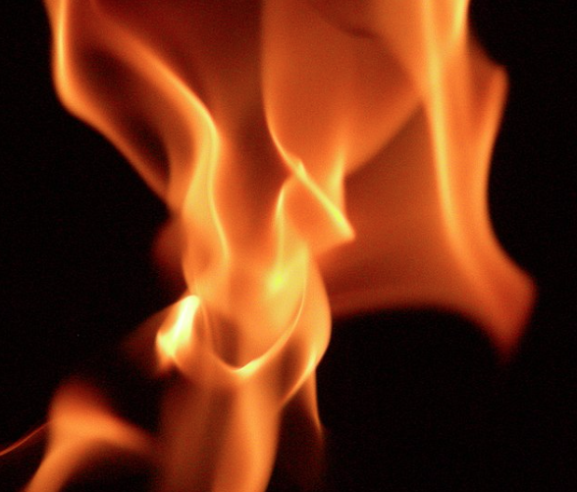
HELIOS The flame of ML
DAEN 690 Project
Spring 2020

Slide 2
HELIO’s 6 Fingers
Tejasri Surapaneni
Aishwarya Maruthappan
Sujan Chava
Venkata Rama Sai Anumula
Vamsidhar Reddy Gunnala
Shourya Simha Addepalli

Slide 3
Problem Definition and Dataset Exploration
Full-Sprint 3 Presentation
06 April 2020

Slide 4
Problem Definition
Realtime detection of anomalies in quality inspection in manufacturing of steel using deep learning-based computer vision.
Statement: Detecting the defects through manual inspection in the manufacturing of steel is difficult, cost effective and can also lead to inappropriate conclusions. The solution to avoid such inaccuracies and to decrease the cost incurring on this process of defect detection, we are developing a computer vision model that is fast enough to determine visual defects in real-time by analysis live stream of images from a camera.

Slide 5
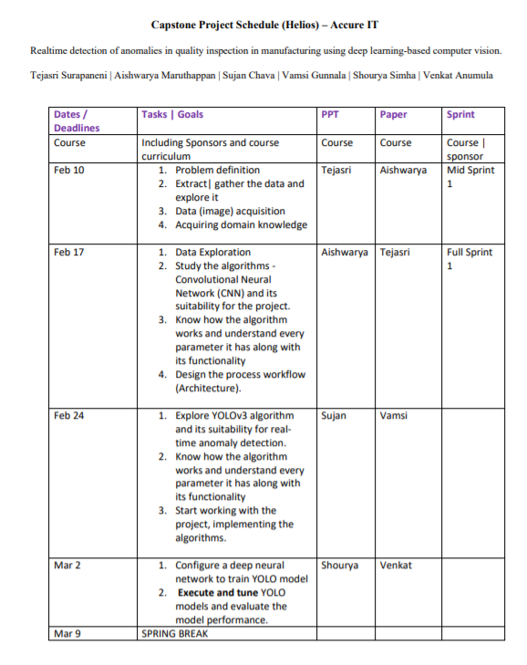
Helios Project Schedule

Slide 6
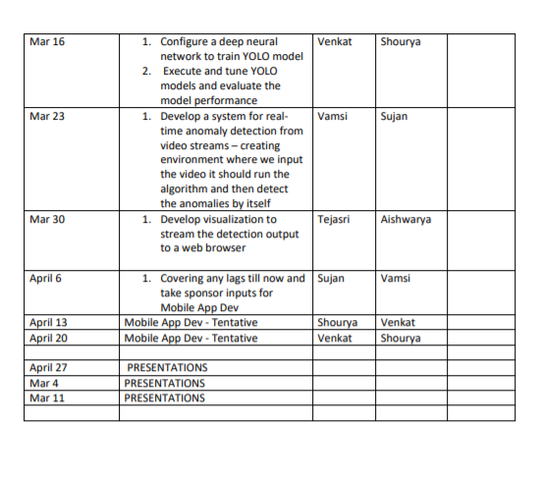
Helios Project Schedule

Slide 7
Sprint 3 Goals
Training the YOLO model and clearing the hassles encountered.
Researching on different ways to handle the HURDLES AND get the desired RESULTS
Re-running the model by TWEAKING AND tuning the parameters of the model.

Slide 8
HELIOS Organization
Team Roles:
Product Owner – Tejasri Surapaneni
Scrum Master – Venkata Rama Sai Anumula
Developers :
Sujan Chava
Aishwarya maruthappan
Vamsidhar Gunnala
Shourya Simha.
Tools
You Track for tracking all Sprints using agile methodology.
Google Colab, Kaggle kernel for execution and computational support.
Shared Git hub repository for CI/CD integration and development.
Own choice of CDI’s for development using python.

Slide 9
Business Rhythm
Sponsors Meeting – Requirements Gathering
Understand the Requirements and acquire suitable data set accordingly
Project Planning, roles assigning , team meeting
Reporting the proceedings and implementation results.
Working team interactions and scrum calls with client
Training the model and researching simultaneously

Slide 10
Potential Data sources
Data sources for initially understanding and developing:
NEU Surface Detection Database . - NEU Database
This dataset has to be split into train(70%) and test datasets(30%).
https://www.kaggle.com/c/severstal-steel-defect-%20detection/overview
http://faculty.neu.edu.cn/yunhyan/NEU_surface_defect_database.html

Slide 11
Data set overview
In the Northeastern University surface defect database, six kinds of surface defects of the hot-rolled steel strip are collected.
They are rolled-in scale (RS), patches (Pa), crazing (Cr), pitted surface (PS), inclusion (In) and scratches (Sc).
The database includes 1,800 grayscale images which consist of 300 samples each of six different kinds of typical surface defects.
In addition to the images we also have Annotations which are used for defect detection task which indicate the class and co-ordinates of a defect in each image.

Slide 12
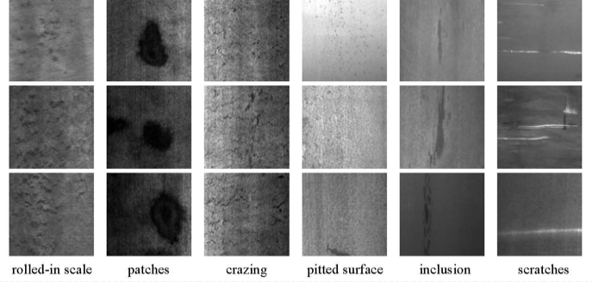
Dataset exploration - Shades of gray

Slide 13
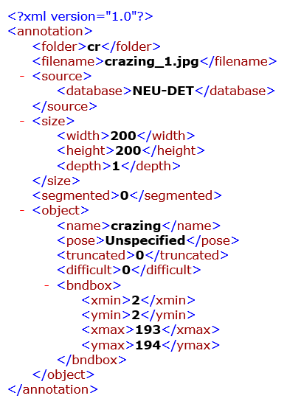
Annotation XML Format

Slide 14
Data Schema
Annotation | Folder - It contains the location where the data is stored.
File name | The name of the file in location.
Source | Database - It contains the information about the database database from where the image is extracted.
Size | Width – Specifies the width of the image Height – Specifies the height of the image Depth – Specifies the depth of the image
Segmented | Specifies how many segments we would like to form in the image.
Object | Name – Specifies the name of the object Pose – This field specifies the co- ordinates of the type of the object to be detected. Truncated – This field specifies whether the objects in the image is truncated or not. Difficult – This field states that there are objects which are annotated as difficult.
Bounding box | This field determines the co – ordinates of the bounding box Xmin – Specifies the lower left corner x co – ordinates dimension of the bounding box. Ymin – Specifies the lower left corner y co-ordinate dimension of the bounding box. Xmax – Specifies the upper right corner x co – ordinate dimension of the bounding box. Ymax- Specifies the upper right corner y co-ordinate dimension of the bounding box.

Slide 15
Data quality assessment
Completeness: The data we had is complete as there are no missing or null values and we aren’t dealing with the structured data but with the unstructured data. As all images are labelled there are no such images which are left without labeling.
Uniqueness: It is difficult to check the uniqueness of the data in the image dataset as the data is in the form of images and we identify through annotations and there are chances that they can be same or not. Probably we should do it through deep fakes which is another level of complexity.
Accuracy: Accuracy is also guaranteed as the dataset is well annotated and retrieved from the sponsor.
Atomicity: As the data is unstructured atomicity doesn’t affect.
Conformity: The quality of conformity is also achieved where the data gathered is meeting the standards like format, size and type etc.
Overall quality: Except few measures like atomicity and uniqueness rest all the measures are guaranteed.

Slide 16
Sprint-3 Goals
Divide the given NEU Dataset into four folders as following
→ Train images (70%)
→ Train Annotations(70%)
→ Test Images(30%)
→ Test Annotations(30%)
Setting Up the Environment in Google Co-lab as shown by sponsor.
Training the Yolo model with the required images as inputs to the model.
Deriving solutions to the problems encountered.
Re-training the models by tuning the values of different parameters in the config file.

Slide 17
Potential Analytics
There are several stunning algorithms in the market for object detection and defect detection.
Based on the outstanding back bone of the algorithms like Image AI, Retina net we chose YOLO algorithms to Implement the defect detection techniques which helps to identify the anomalies in the manufactured goods using the computer vision.
Potential analytics identified

Slide 18
YOLO MODEL- YOU ONLY Look ONCE
- YOLO is a CNN for doing object detection in real time
- The algorithm applies a single neural network to full image, divides image into regions and predicts the region where the object lies and probabilities of each region within an image
- The algorithm looks only once at the image and makes predictions accordingly.

Slide 19
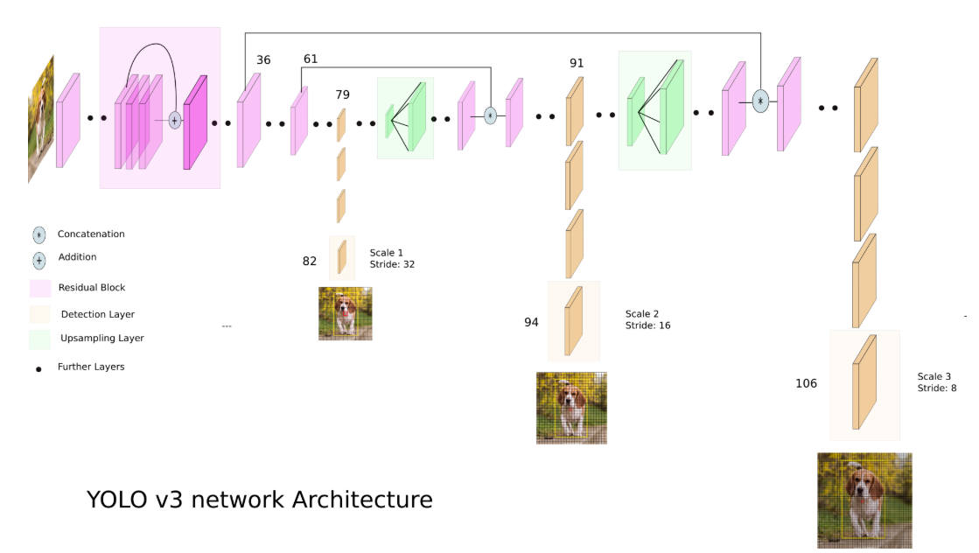
YOLO_V3 Architecture

Slide 20
Converting the .xml files to required .txt file format.
Creating the train.txt, test.txt and class.data files in the required format.
Cloning the required git-hub repository.
Creating input.cfg and other required files and folders and setting them up in google co-lab environment for running the yolo model
Training the yolo model
Tuning the parameters (width, height, max batch size etc) in the config file and re-running the model accordingly.
Full-Sprint 3

Slide 21
Inputs for YOLO_V3
Yolo_v3 takes the annotation files as inputs only if they are in the following format:
Class, x-center, y-center, width, height
Class → Class of the defect present in the image
X-center → Mid-point of x-coordinates of bounding box with respect to image.
Y-center → Mid-point of y-coordinates of bounding box with respect to image.
Width → Width of the bounding box of the defect w.r.t image.
Height → Height of the bounding box of the defect w.r.t image.

Slide 22
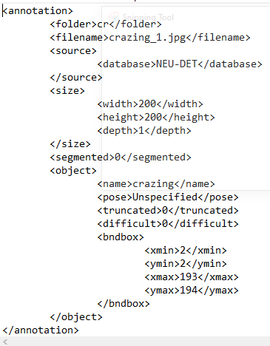
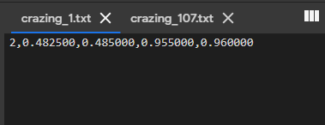
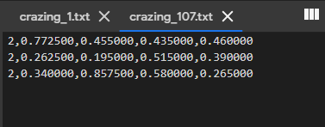
Converting all the annotations .xml files into .txt which has data in the above Format
If the image has defect at only one location .txt file looks like image shown below.
If the image has defect at more than one location .txt file looks like image shown below.

Slide 23
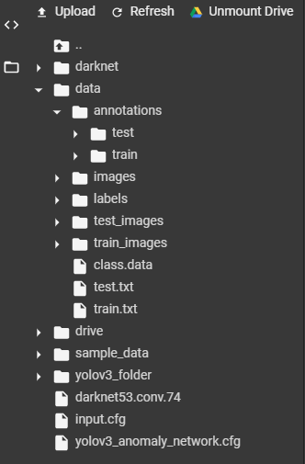
Data Structure For yolo Model
The required repository (darknet) is cloned from github along with pre-trained weights (darknet53. conv.74) for yolo model into co-lab environment.
All the images (train & test) are moved to images folder of co-lab environment.
All the converted annotations (.txt) files are moved to labels folder of co-lab environment.
We need to create three files train.txt, test.txt and class.data with each containing data as follows:
Train.txt → Absolute path to all the train images.
Test.txt → Absolute path to all the test images.
Class.data → Names of all the different defects we have, with each defect written in each line.

Slide 24
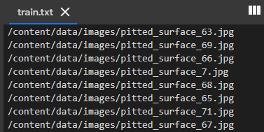
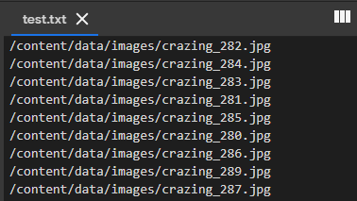
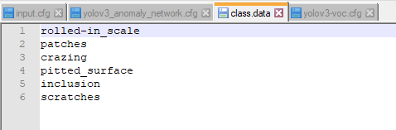
train.txt
test.txt
class.data
Note: All these files can be created in out drive using which we can save all these data, but doing so will end up having space(‘ ‘) in absolute paths to images in train and test which causes problem while training and testing the model. Because of this reason we are loading the entire data into colab environment.
Ex: ‘/content/drive/My Drive/Capstone/train_images/crazing_1.jpg’

Slide 25
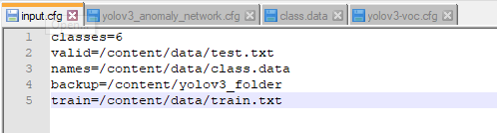
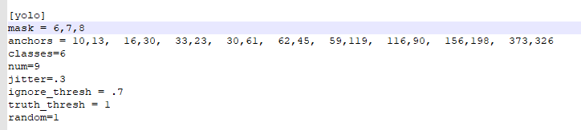
Creating input.cfg and making changes to yolo_v3.cfg file for running the model on our dataset.
Input.cfg
We have to create an input.cfg file which has the following data in it.
YOLO_V3.cfg
Under Cfg folder of darknet folder that we have cloned from github we have yolo_v3.cfg file. Download it and make necessary changes to it in the yolo layer by changing the classes and filters to train the model on dataset.

Slide 26
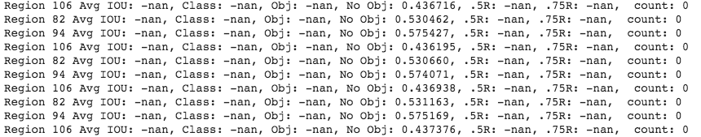
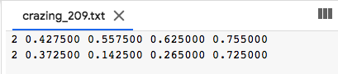
Training the model
Initially after creating the input.cfg file and making necessary changes in the yolov3.cfg we trained the model using these files as inputs and we observed the following as output.
We tried figuring out this blocker and found that the reason behind this was the commas in the annotations .txt files.

Slide 27
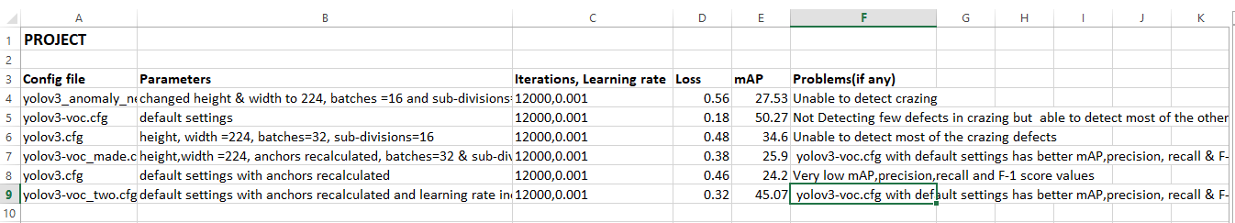
Sprint-3 Tweaking the cfg files for better accuracy.
Different models we have trained with different parameters and problems we faced.

Slide 28
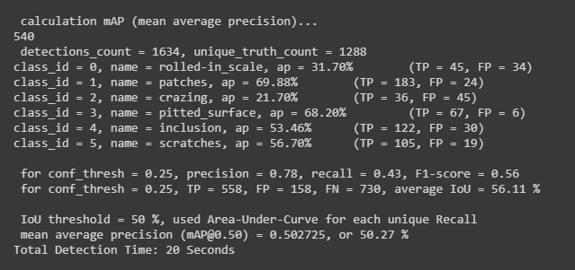
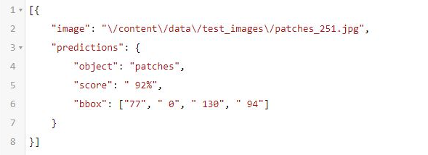
result's Of the BEST model
Predictions

Slide 29
Sprint – 4:
After predicting all the defects and bounding boxes of the test images (.json format) using the best model, we have drawn bounding boxes on the test images along with the class of the defect.
The predictions are shown in the below slides.
Also we have tried to predict the defects using the best model, present in certain steel surface videos which are shown in the slides below.
Also we need to make few plots related to loss vs iteration.
There is one more team working on same project using ssd model, we have compared the results of both the models to find the best model or algorithm that can be used for finding the defects.

Slide 30
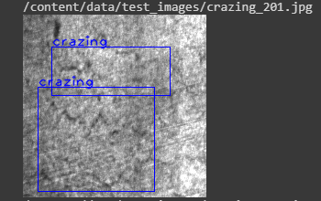
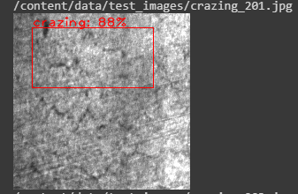
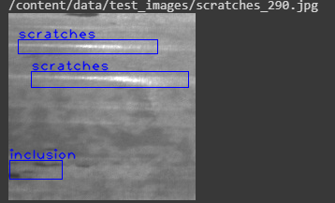
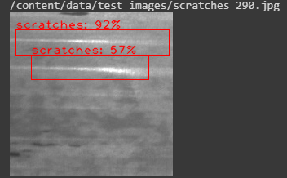
Predictions of Best Model with bounding box in the images
Defects
Crazing
Scratches
Actual
Predicted

Slide 31
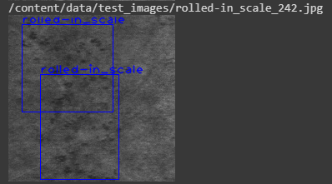
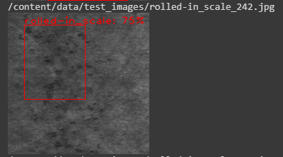
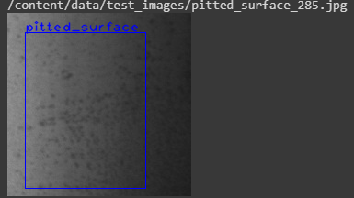
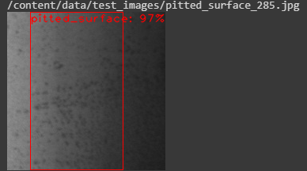
Predictions of Best Model with bounding box in the images
Defects
R-in-scale
Pitted-sur
Actual
Predicted

Slide 32
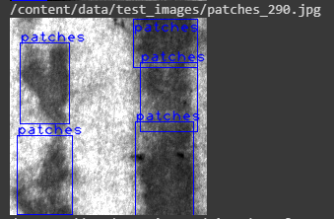
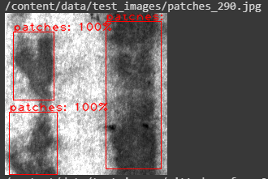
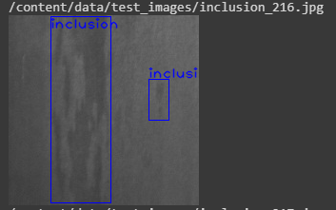
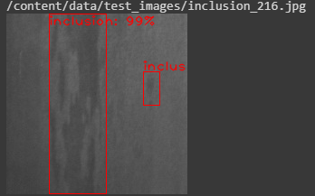
Predictions of Best Model with bounding box in the images
Defects
Patches
Inclusion
Actual
Predicted

Slide 33
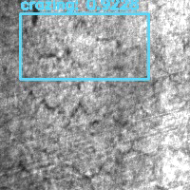
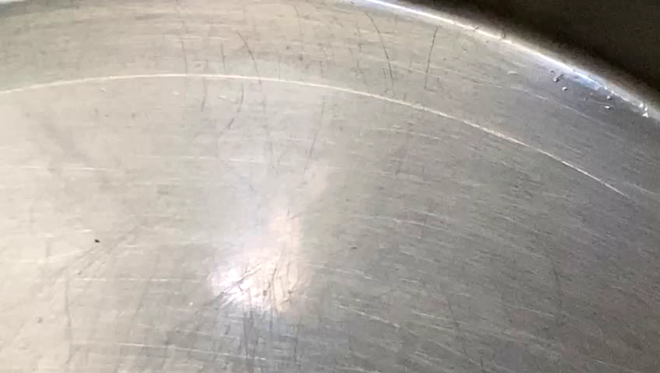
Predictions on a Video:
All the test-set images are merged together to form a video with 5 fps
→ Prediction using a steel plate

Slide 34
Project Flow chart
Problem Definition
Introduction call with sponsor to know all the requirements and get clear understanding of the problem
Data Acquisition and Exploration
Extract and gather the required image data for analysis
To understand how various defects can be identified and annotated.
Analytics and Algorithm
Understanding the working principle of YOLO v3 algorithm
Setting Up the Environment in Google Co-lab as shown by sponsor
Splitting the dataset into Train and Test
(70% Train and 30% Test)
Acquiring domain knowledge on how to handle XML data.
Converting the .xml files to required file format.
Creating the train.txt, test.txt and class.data files in the required format.
Analytics and Algorithm
(Cont..)
Cloning the required git-hub repository.
Creating the input files for training the model like input.cfg and yoylov3.cfg.
Training the Model
Trained the model using the created input files
Had a blocker where the annotated text file created is not read properly and leading IOU to show as nan.
Resolved this issue by eliminating the commas in the annotated text file.
The model is re-run and IOU could estimate the accuracy, but the model isn’t detecting few defects - crazing.
Trying to train the model using different .cfg files and finding the model with best accuracy on test set.

Slide 35
Complexity RATIO
DAEN 690
Understanding of Complexity

Slide 36
Risks and Planned Mitigations
Data is unstructured and labelled by another research team from NEU.
- XML dataset for annotated images
- Understanding the structure and attributes of it to modulate.
The processing capabilities and computing power
Probability: Medium
Mitigations: Training the model based on a single video/image and then work on the subsets of data to determine the computational power and resources required to improve the latency.
Visualization: Stream the detection output to a web browser
Mitigation: work on versatility and compatibility on the visualization we provide so that it supports the visibility of the content clearly.
Mobile application development: stretch to the project and a question on time complexity.
Risks Identified and Mitigation Plan

Slide 37
Assumptions
Data: The data to be used is the supervised unstructured data which is labelled by the NEU research team based on the domain expertise. The annotated images are in .xml format.
Implementation: We should develop a model where the model should detect the anomalies in the image dataset and then the performance should be the same for a video too.
Result: When an image or a video of the manufacturing goods is given as an input to the model, then the anomalies or defects are detected, and highlighted with a rectangular boundaries to emphasize the pixel portions of the image and in a video.
Visualizations: Visualizations should be developed in such a way that the detection of the output should be streamed to a web browser.
Stretch: We are also planning to develop a mobile app where if we upload or take a video of the manufacturing goods then it should automatically detect the defects and anomalies in the goods.

Slide 38
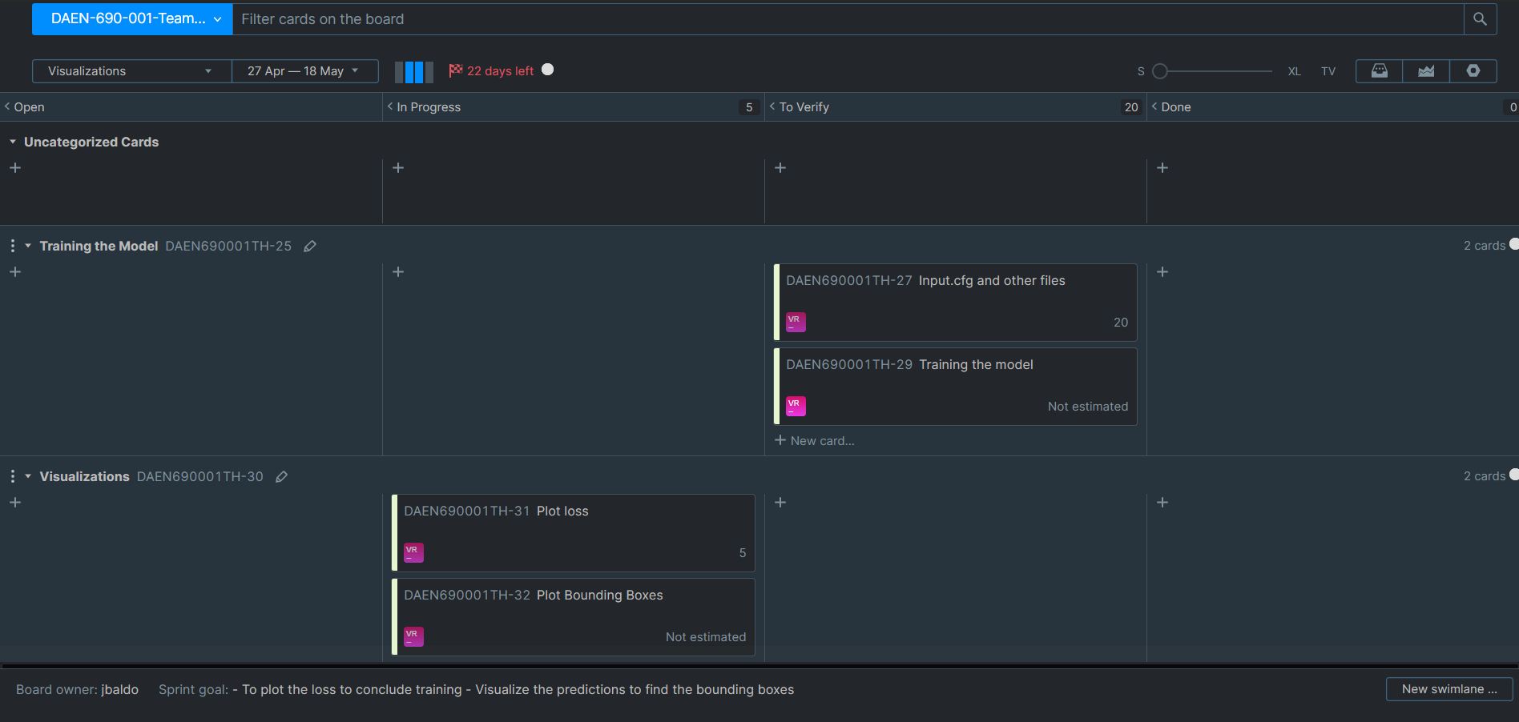
YouTrack Updates:

Slide 39


Slide 40


